Slide 1
Cs final project
Clay jackson

Slide 2

Objective
Create a Python Program that simulates a Roulette Wheel at a casino
Allow the user to not only win or lose but bet money and keep track of how much they have won or lost.
Among several other things, implement classes, functions and loops.

Slide 3
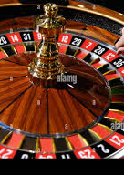
What is roulette?
Roulette is a popular casino game. It is a wheel that consists of numbers from 0-36, interchanging between black and red. You spin the wheel and roll a ball. The ball will land on one number.
Before the spin, a player may choose to place a bet on a specific number or a various grouping of numbers (odd or even, red or black)
Payout:
Odd or even: 2-1
Black or red: 2-1
A specific number: 35-1

Slide 4
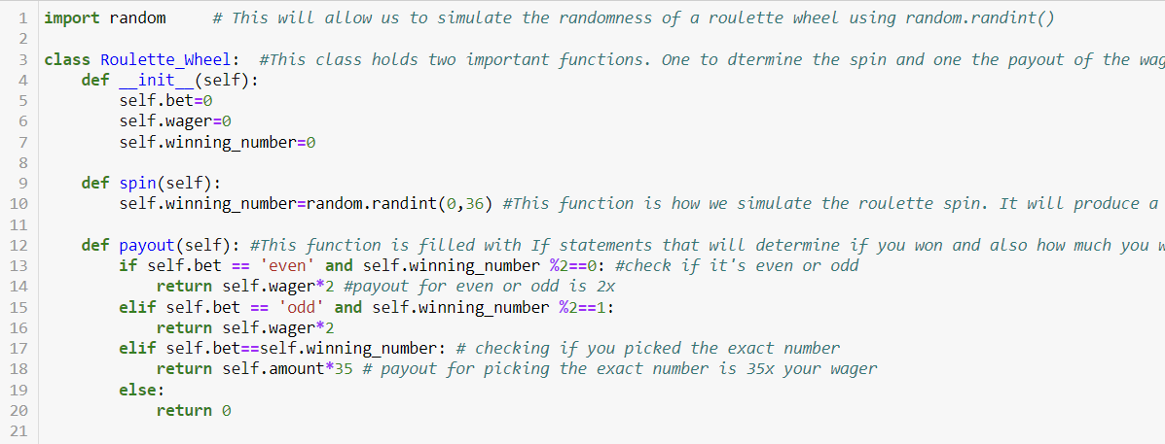
Project flow
1. Import Random
Import Random, Class #1 (initialize), random.randint(), payout determined using If statements

Slide 5
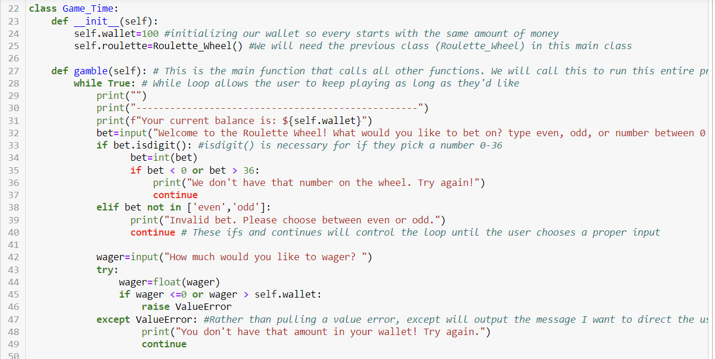
Project flow (continued)
Initialize wallet, while loop, controlling user input (if statements, not in, raise, except ValueError)

Slide 6
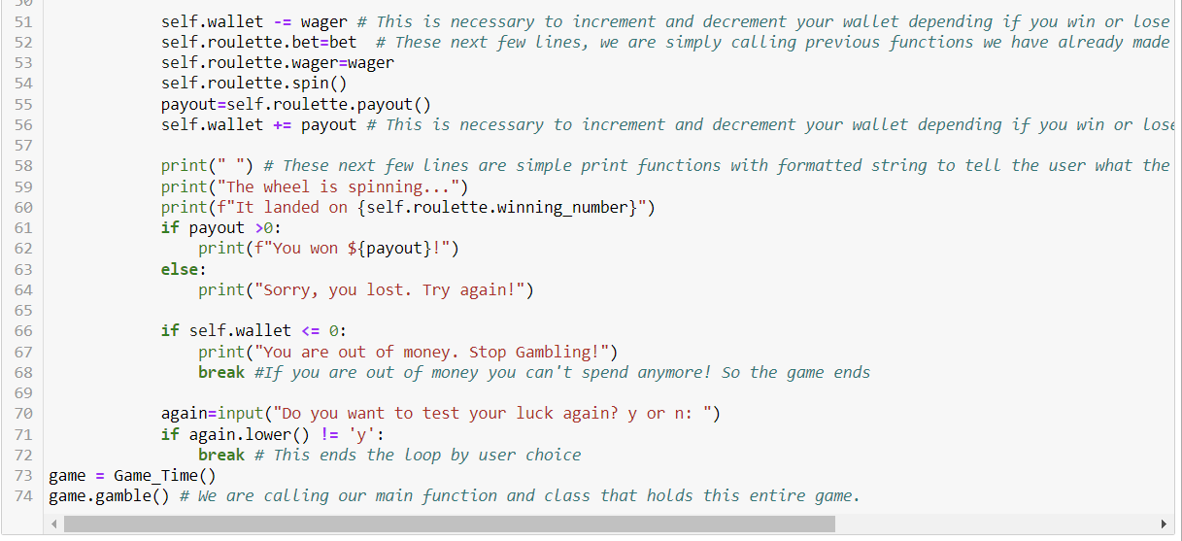
Project flow (continued)
Increment/decrement, calling functions, communicating with user (print, formatted string), ending loops, running the program

Slide 7
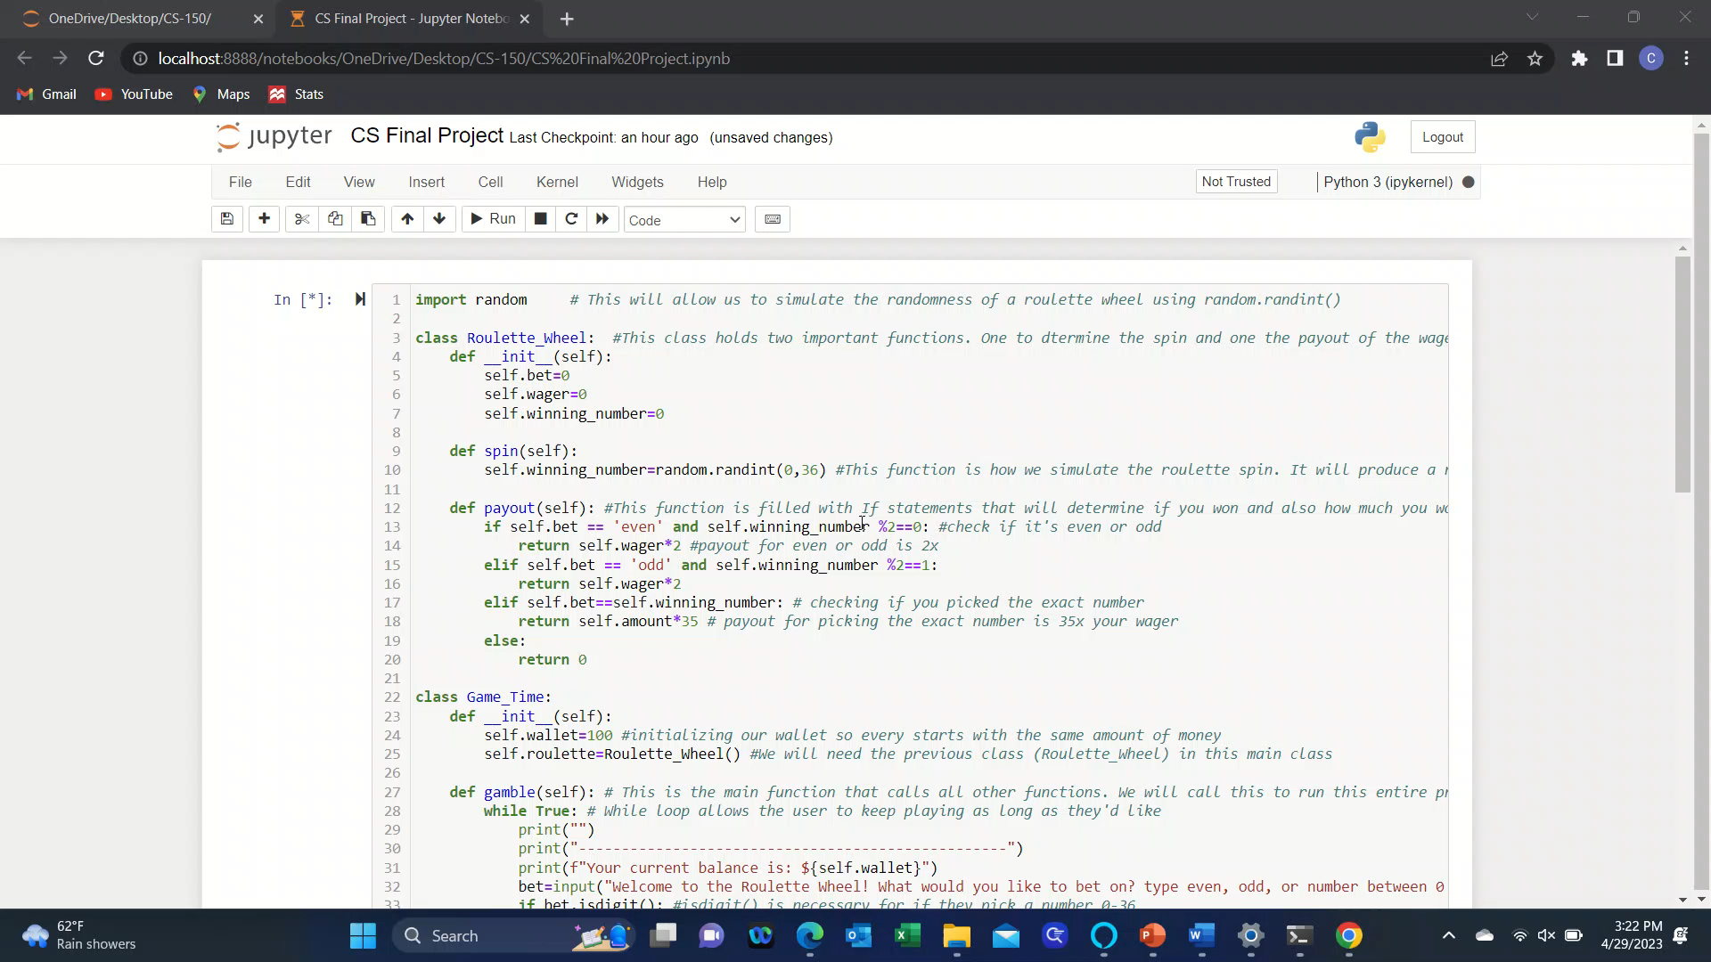
Video

Slide 8
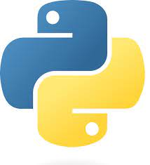
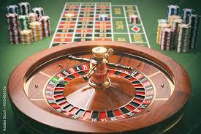
Result
Using Python programming, it was possible to write a code that simulates gambling on a casino roulette wheel.

Slide 9
Questions?

Slide 10
Thank You

